Slide 1
Descriptive Analysis of 911 Calls Baltimore

Slide 2
Jolly Jaguars
Samarjith
Divya
Akash

Slide 3
Our Process
SOURCE FILE
DATA CLEANING
ANALYSIS
VISUALIZATION

Slide 4
Target Audience:
Baltimore County Police Department
Prospective home buyers in Baltimore

Slide 5
1. Are more 911 calls related to burglary made during the night? Or is that just a preconceived notion?

Slide 6
Data Cleaning
Time:
Standardize the call-date column to remove the date values
Use the chron library in R to convert to Time format
Description:
Identify all the “burglary” related calls in the description column and change them all to read ‘Burglary’

Slide 7
Descriptive Analysis
Categorize the time into Morning (5AM-11AM), Afternoon (11AM-5PM), Evening (5PM - 11PM), and Night (11PM - 5AM)
Obtain the burglary calls count for each time of the dayPlot the data

Slide 8
Visualizations

Slide 9
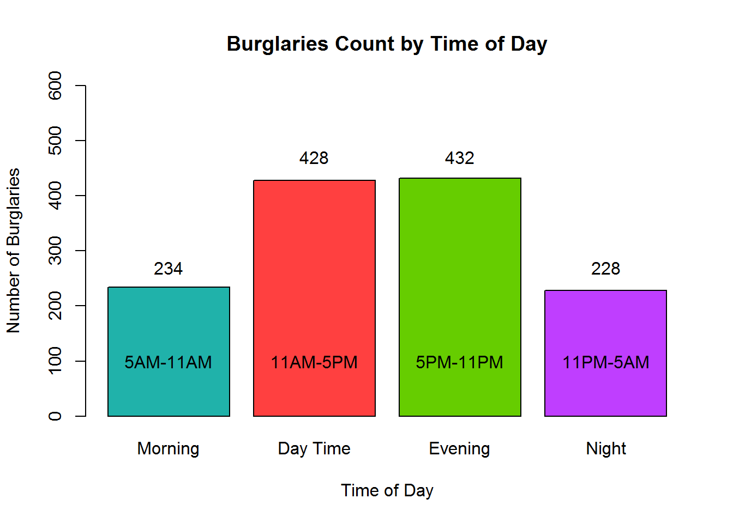
Total No Voice Calls

Slide 10
Conclusion
As observed the majority of the burgalaries take place during the “Daytime” and “Evening Time” of the day! This is in sharp contrast to the preconceived notion that burglaries usually take place after midnight.

Slide 11
2. Whether the number of blank calls increase/decrease with the arrival of the weekend?

Slide 12
Data Cleaning
Standardize the call-date column according to requirements in excel.
Group all “No Voice” and “Hangup” values in the description column.
Removing date and time from the call-date column.
Converting date column into date format.
Converting time column into chrono format.

Slide 13
Descriptive Analysis
Converting the dates into days.
Identifying the weekends.
Identifying calls made on a friday after 19:00.
Compare the number of “No Voice” and “Hangup” calls made per day of the week.
Then compare in terms of weekend vs weekday.
Categorize weekend in such a way and such that it includes calls made on friday after 19:00 also. Weekday will comprise of the rest of the calls.
Generate visualizations to depict findings.

Slide 14
Weekend vs Weekday
(NO VOICE & HANGUP)
 | NO VOICE (Weekend with Friday) | NO VOICE (Weekend without Friday) | HANGUP (Weekend with Friday) | HANGUP (Weekend without Friday)
Weekend | 2895 | 2563 | 32 | 28
Weekday | 6516 | 6848 | 53 | 57
TOTAL | 9411 | 9411 | 85 | 85

Slide 15
Visualizations

Slide 16
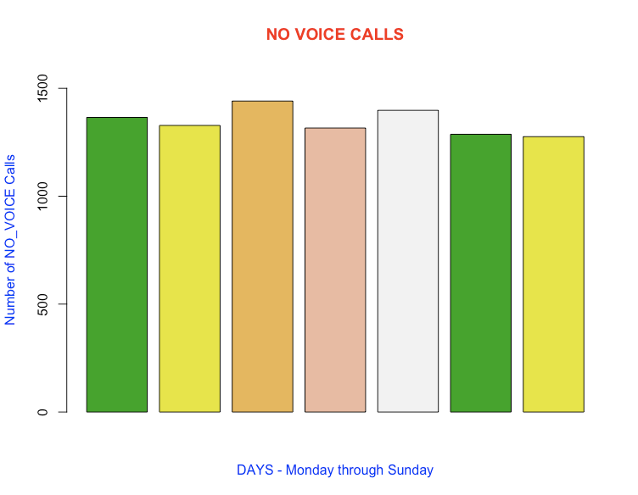
Total No Voice Calls

Slide 17
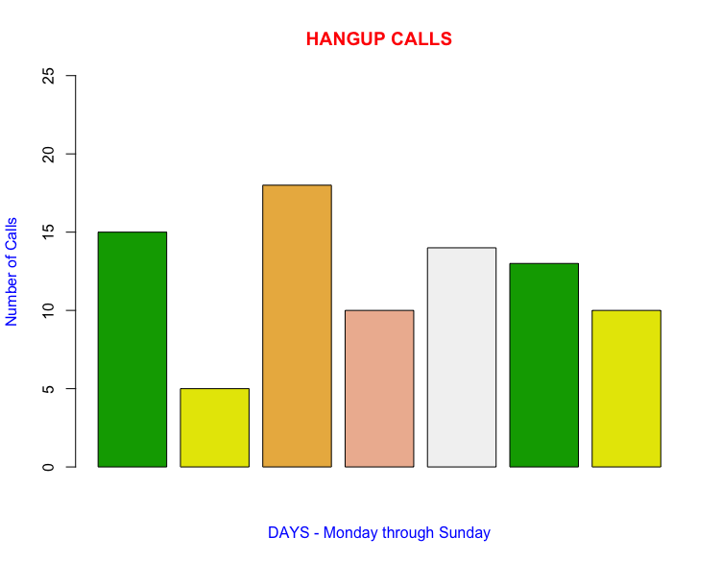
Total Hangup Calls

Slide 18
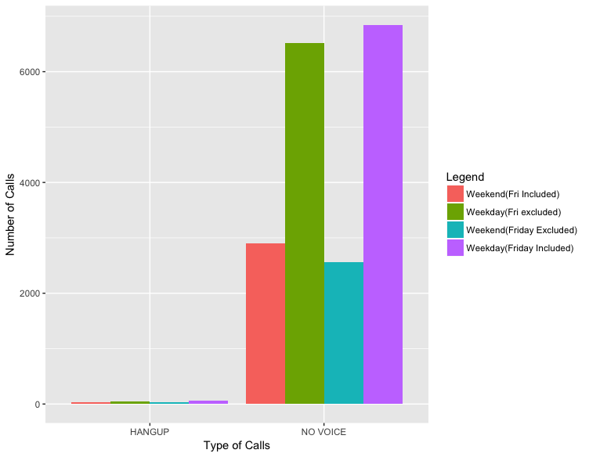
Weekend vs Weekday

Slide 19
Conclusion
We do not have significant evidence to prove that the weekend has any effect on the number of “No Voice” and “Hangup” calls received. The takeaways are that the “No Voice” calls are quite evenly distributed throughout the week. There is a slight peak in the number of “No Voice” calls made during wednesday and friday. Also the “No Voice” and “Hangup” calls can be different types of calls, due to the differences in the observation made.

Slide 20
3. Top dangerous 911 calls and their locations

Slide 21
Data Cleaning
Took a different dataset for answering this question - Downloaded a sample of our dataset where the call-date column had values starting from 01 January 2016 upto 10th Dec 2016.
Removed all rows having location values as (,) and (0.000000,0.000000) by filtering the data in Excel.
Split the location column values into two columns Latitude and Longitude in Excel using the 'Text to Columns' option.

Slide 22
Descriptive Analysis
Selected the top dangerous reasons for 911 calls as 'Aggravated Assault','Destruction of property','Discharge Firearm/Shooting' and 'Robbery'
Grouped similar descriptions having different case and spellings under relevant common labels

Slide 23
Top Dangerous 911 calls
Description Labels | Common Label
AGGRAV ASSAULT | Aggravated Assault
Aggrav Assault
DESTRUCT PROP | Destruction of property
DESTRUCT PROPTY
Destruct Propty
DISCHRG FIREARM | Discharge Firearm & Shooting
Dischrg Firearm
SHOOTING
Shooting
ROBBERY ARMED | Robbery
Robbery Armed
ROBBERY UNARMED
Robbery Unarmed

Slide 24
Visualizations

Slide 25
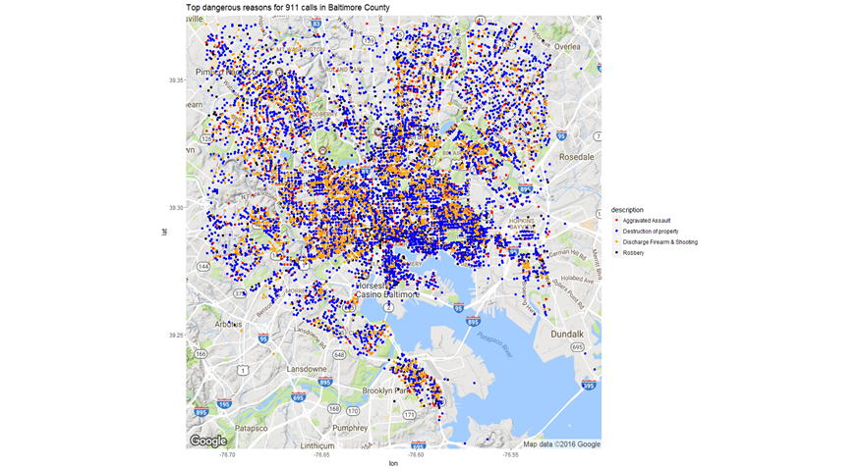

Slide 26
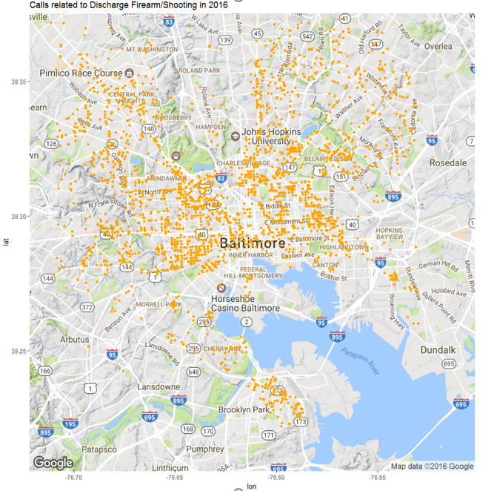
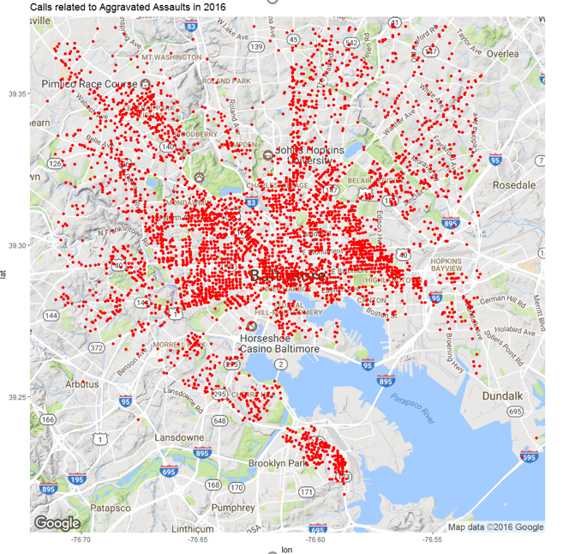

Slide 27
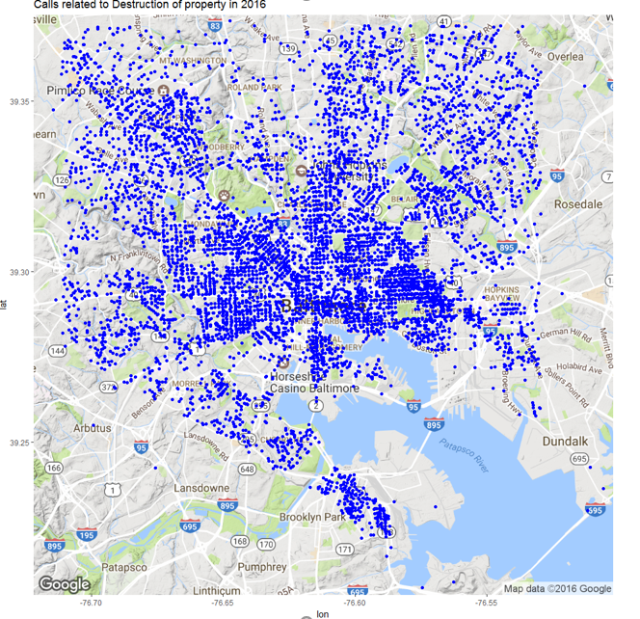
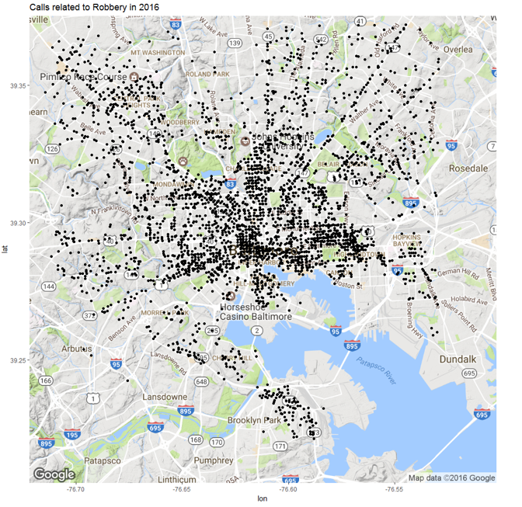

Slide 28
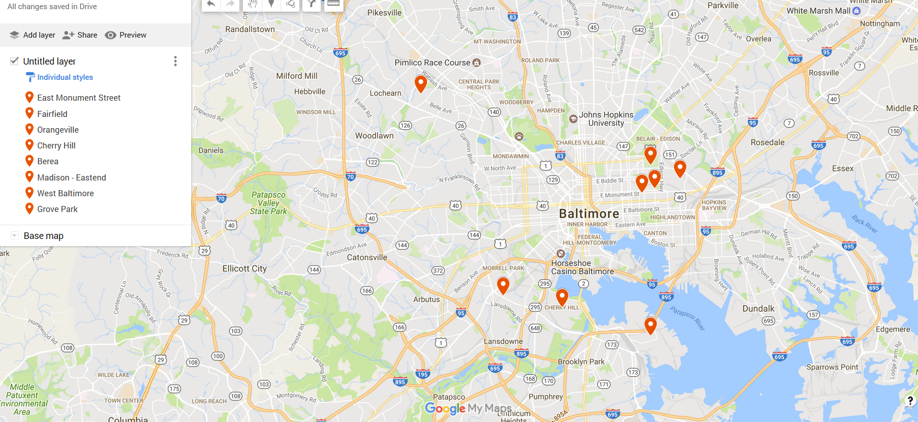

Slide 29
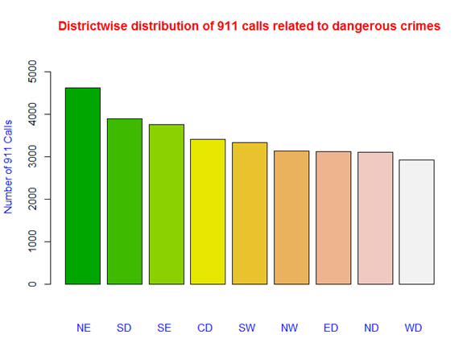

Slide 30
Conclusion
Our analysis tells us that ‘Destruction of Property’ is the topmost dangerous reason for 911 calls, followed by ‘Aggravated Assaults’, ‘Robbery’ and ‘Shooting’ respectively.
The concentration of 911 calls decreases as we move from the centre towards the boundaries.
The coastal area near the center (Inner Harbor) have more reported crime as compared to the remaining coastal areas

Slide 31
Thanks!
Any questions?

